Slide 1
Array Mapping (V1)
Practise Problems

Slide 2
Assume base address of an 1D int array Arr starts at 0’th byte. To store an Integer number, it takes 4 bytes. Find the memory address of Arr[3] assuming the array starts at 0’th index.

Slide 3
Assume base address of an 1D int array Arr starts at 100’th byte. To store an Integer number, it takes 4 bytes. Find the memory address of Arr[32] assuming the array starts at 0’th index.
100 + 32 * 4 = 228

Slide 4
Assume base address of an 1D int array Arr starts at 100’th byte. To store an Integer number, it takes 4 bytes. Find the memory address of Arr[32] assuming the array starts at 0’th index.

Slide 5
Assume base address of an 1D int array Arr starts at 0’th byte. To store an Integer number, it takes 4 bytes. Find the memory address of Arr[3] assuming the array starts at 0’th index.
0 + 3 * 4 = 12

Slide 6
Assume base address of an 1D int array Arr starts at B byte. To store an Integer number, it takes L bytes. Find the memory address of Arr[i] assuming the array starts at 0’th index.

Slide 7
Assume base address of an 1D int array Arr starts at B byte. To store an Integer number, it takes L bytes. Find the memory address of Arr[i] assuming the array starts at 0’th index.
B + i * L

Slide 8
Assume base address of an 1D int array Arr starts at 0’th byte. To store an Integer number, it takes 4 bytes. Find the memory address of Arr[2] assuming the array starts at 1’st index.

Slide 9
Assume base address of an 1D int array Arr starts at 0’th byte. To store an Integer number, it takes 4 bytes. Find the memory address of Arr[2] assuming the array starts at 1’st index.
0 + (2 – 1) * 4

Slide 10
Assume base address of an 1D int array Arr starts at 0’th byte. To store an Integer number, it takes 4 bytes. Find the memory address of Arr[20] assuming the array starts at 1’st index.

Slide 11
Assume base address of an 1D int array Arr starts at 0’th byte. To store an Integer number, it takes 4 bytes. Find the memory address of Arr[20] assuming the array starts at 1’st index.
0 + (20 – 1) * 4

Slide 12
Assume base address of an 1D int array Arr starts at 100’th byte. To store an Integer number, it takes 4 bytes. Find the memory address of Arr[10] assuming the array starts at 1’st index.

Slide 13
Assume base address of an 1D int array Arr starts at 100’th byte. To store an Integer number, it takes 4 bytes. Find the memory address of Arr[10] assuming the array starts at 1’st index.
100 + (10 – 1) * 4

Slide 14
Assume base address of an 1D int array Arr starts at B byte. To store an Integer number, it takes L bytes. Find the memory address of Arr[i] assuming the array starts at 1’st index.

Slide 15
Assume base address of an 1D int array Arr starts at B byte. To store an Integer number, it takes L bytes. Find the memory address of Arr[i] assuming the array starts at 1’st index.
B + (i – 1) * L

Slide 16
Assume base address of an 1D int array Arr starts at B byte. To store an Integer number, it takes L bytes. Find the memory address of Arr[i] assuming the array starts at lb index.
For example: Arr[lb, …, ub]

Slide 17
Assume base address of an 1D int array Arr starts at B byte. To store an Integer number, it takes L bytes. Find the memory address of Arr[i] assuming the array starts at lb index.
For example: Arr[lb, …, ub]
B + (i – lb) * L

Slide 18
2D Array Mapping
Row Major Mapping
Column Major Mapping

Slide 19
Row Major Mapping
Arr[0][0] 200 | Arr[0][1] 204 | Arr[0][2] 208
Arr[1][0] 212 | Arr[1][1] 216 | Arr[1][2] 220
Arr[2][0] 224 | Arr[2][1] 228 | Arr[2][2] 232
Arr[3][0] 236 | Arr[3][1] 240 | Arr[3][2] 244
Row 0
Row 1
Row 2
Row 3
[0][0]
[0][1]
[0][2]
[1][0]
[1][1]
[1][2]
[2][0]
[2][1]
[2][2]
[3][0]
[3][1]
[3][2]
200
204
208
212
216
220
224
228
232
236
240
244
Actual array mapping to memory
Our array representation

Slide 20
Row Major Mapping
Arr[0][0] 200 | Arr[0][1] 204 | Arr[0][2] 208
Arr[1][0] 212 | Arr[1][1] 216 | Arr[1][2] 220
Arr[2][0] 224 | Arr[2][1] 228 | Arr[2][2] 232
Arr[3][0] 236 | Arr[3][1] 240 | Arr[3][2] 244
Find the Address of Arr[2][1]. Assuming both
index start from 0’th index. Base address of Arr is 200.
An integer takes 4 bytes of memory

Slide 21
Row Major Mapping
Arr[0][0] 200 | Arr[0][1] 204 | Arr[0][2] 208
Arr[1][0] 212 | Arr[1][1] 216 | Arr[1][2] 220
Arr[2][0] 224 | Arr[2][1] 228 | Arr[2][2] 232
Arr[3][0] 236 | Arr[3][1] 240 | Arr[3][2] 244
Find the Address of Arr[2][1]. Assuming both
index start from 0’th index. Base address of Arr is 200.
An integer takes 4 bytes of memory
200 + [2 * 3 + 1] * 4 = 228

Slide 22
Row Major Mapping
Arr[0][0] 200 | Arr[0][1] 204 | Arr[0][2] 208
Arr[1][0] 212 | Arr[1][1] 216 | Arr[1][2] 220
Arr[2][0] 224 | Arr[2][1] 228 | Arr[2][2] 232
Arr[3][0] 236 | Arr[3][1] 240 | Arr[3][2] 244
Find the Address of Arr[1][2]. Assuming both
index start from 0’th index. Base address of Arr is 200.
An integer takes 4 bytes of memory

Slide 23
Row Major Mapping
Arr[0][0] 200 | Arr[0][1] 204 | Arr[0][2] 208
Arr[1][0] 212 | Arr[1][1] 216 | Arr[1][2] 220
Arr[2][0] 224 | Arr[2][1] 228 | Arr[2][2] 232
Arr[3][0] 236 | Arr[3][1] 240 | Arr[3][2] 244
Find the Address of Arr[1][2]. Assuming both
index start from 0’th index. Base address of Arr is 200.
An integer takes 4 bytes of memory
200 + [1 * 3 + 2] * 4 = 220

Slide 24
Row Major Mapping
Arr[0][0] 200 | Arr[0][1] 204 | Arr[0][2] 208
Arr[1][0] 212 | Arr[1][1] 216 | Arr[1][2] 220
Arr[2][0] 224 | Arr[2][1] 228 | Arr[2][2] 232
Arr[3][0] 236 | Arr[3][1] 240 | Arr[3][2] 244
Find the Address of Arr[3][2]. Assuming both
index start from 0’th index. Base address of Arr is 200.
An integer takes 4 bytes of memory

Slide 25
Row Major Mapping
Arr[0][0] 200 | Arr[0][1] 204 | Arr[0][2] 208
Arr[1][0] 212 | Arr[1][1] 216 | Arr[1][2] 220
Arr[2][0] 224 | Arr[2][1] 228 | Arr[2][2] 232
Arr[3][0] 236 | Arr[3][1] 240 | Arr[3][2] 244
Find the Address of Arr[3][2]. Assuming both
index start from 0’th index. Base address of Arr is 200.
An integer takes 4 bytes of memory
200 + [3 * 3 + 2] * 4 = 244

Slide 26
Row Major Mapping
Arr[0][0] 200 | Arr[0][1] 204 | Arr[0][2] 208
Arr[1][0] 212 | Arr[1][1] 216 | Arr[1][2] 220
Arr[2][0] 224 | Arr[2][1] 228 | Arr[2][2] 232
Arr[3][0] 236 | Arr[3][1] 240 | Arr[3][2] 244
Find the Address of Arr[0][2]. Assuming both
index start from 0’th index. Base address of Arr is 200.
An integer takes 4 bytes of memory

Slide 27
Row Major Mapping
Arr[0][0] 200 | Arr[0][1] 204 | Arr[0][2] 208
Arr[1][0] 212 | Arr[1][1] 216 | Arr[1][2] 220
Arr[2][0] 224 | Arr[2][1] 228 | Arr[2][2] 232
Arr[3][0] 236 | Arr[3][1] 240 | Arr[3][2] 244
Find the Address of Arr[0][2]. Assuming both
index start from 0’th index. Base address of Arr is 200.
An integer takes 4 bytes of memory
200 + [0 * 3 + 2] * 4 = 208

Slide 28
Row Major Mapping
Arr[0][0] 200 | Arr[0][1] 204 | Arr[0][2] 208
Arr[1][0] 212 | Arr[1][1] 216 | Arr[1][2] 220
Arr[2][0] 224 | Arr[2][1] 228 | Arr[2][2] 232
Arr[3][0] 236 | Arr[3][1] 240 | Arr[3][2] 244
Find the Address of Arr[2][0]. Assuming both
index start from 0’th index. Base address of Arr is 200.
An integer takes 4 bytes of memory

Slide 29
Row Major Mapping
Arr[3…6, 5…7]

Slide 30
Row Major Mapping
Arr[3…6, 5…7]
Find the Address of Arr[6][7].
Arr[3][5] 200 | Arr[3][6] 204 | Arr[3][7] 208
Arr[4][5] 212 | Arr[4][6] 216 | Arr[4][7] 220
Arr[5][5] 224 | Arr[5][6] 228 | Arr[5][7] 232
Arr[6][5] 236 | Arr[6][6] 240 | Arr[6][7] 244

Slide 31
Row Major Mapping
Arr[3…6, 5…7]
Find the Address of Arr[6][7].
Arr[3][5] 200 | Arr[3][6] 204 | Arr[3][7] 208
Arr[4][5] 212 | Arr[4][6] 216 | Arr[4][7] 220
Arr[5][5] 224 | Arr[5][6] 228 | Arr[5][7] 232
Arr[6][5] 236 | Arr[6][6] 240 | Arr[6][7] 244
200 + [ (6-3)*(7-5+1) + (7-5) ] * 4
= 200 + 44 = 244

Slide 32
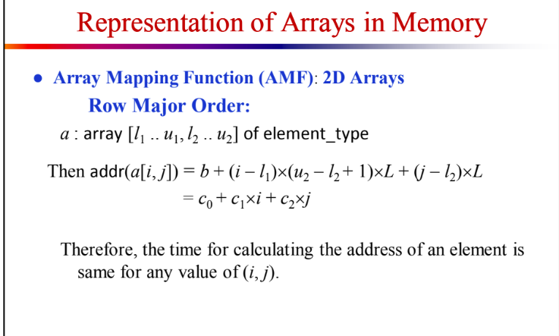

Slide 33
Column Major Mapping
Arr[0][0] 200 | Arr[0][1] 216 | Arr[0][2] 232
Arr[1][0] 204 | Arr[1][1] 220 | Arr[1][2] 236
Arr[2][0] 208 | Arr[2][1] 224 | Arr[2][2] 240
Arr[3][0] 212 | Arr[3][1] 228 | Arr[3][2] 244
Col 0
Col 1
Col 2
[0][0]
[1][0]
[2][0]
[3][0]
[0][1]
[1][1]
[2][1]
[3][1]
[0][2]
[1][2]
[2][2]
[3][2]
200
204
208
212
216
220
224
228
232
236
240
244
Actual array mapping to memory
Our array representation

Slide 34
Column Major Mapping
Arr[0][0] 200 | Arr[0][1] 216 | Arr[0][2] 232
Arr[1][0] 204 | Arr[1][1] 220 | Arr[1][2] 236
Arr[2][0] 208 | Arr[2][1] 224 | Arr[2][2] 240
Arr[3][0] 212 | Arr[3][1] 228 | Arr[3][2] 244
Find the Address of Arr[3][2].
200 + [ 2*4 + 3] * 4
= 200 + 44 = 244

Slide 35
Col Major Mapping
Arr[3…6, 5…7]
Find the Address of Arr[5][7].
Arr[3][5] 200 | Arr[3][6] 216 | Arr[3][7] 232
Arr[4][5] 204 | Arr[4][6] 220 | Arr[4][7] 236
Arr[5][5] 208 | Arr[5][6] 224 | Arr[5][7] 240
Arr[6][5] 212 | Arr[6][6] 228 | Arr[6][7] 244

Slide 36
Col Major Mapping
Arr[3…6, 5…7]
Find the Address of Arr[5][7].
Arr[3][5] 200 | Arr[3][6] 216 | Arr[3][7] 232
Arr[4][5] 204 | Arr[4][6] 220 | Arr[4][7] 236
Arr[5][5] 208 | Arr[5][6] 224 | Arr[5][7] 240
Arr[6][5] 212 | Arr[6][6] 228 | Arr[6][7] 244
200 + [ (7-5)*(6-3+1) + (5-3) ] * 4
= 200 + 40 = 240

Slide 37
(a) Consider a memory system with row-wise memory allocation, a double array X[128][64] where each double is 8 bytes. Let X[20][10] = m + 50000 where m is the last 2 digits of your student id.
[Example; if student id = 0112410261 ,then m = 61] Calculate the memory address of beginning of the array and X[22][15].
(b) If the system was column-wise will there be any changes to the result. Show your reasoning.

Slide 38

For m = 61:
Row-major:
$\text{addr}\left(X\left[0\right]\left[0\right]\right)=39741$
$\text{addr}\left(X\left[22\right]\left[15\right]\right)=51125$
Column-major:
$\text{addr}\left(X\left[0\right]\left[0\right]\right)=39661$
$\text{addr}\left(X\left[22\right]\left[15\right]\right)=55 197$

Slide 39
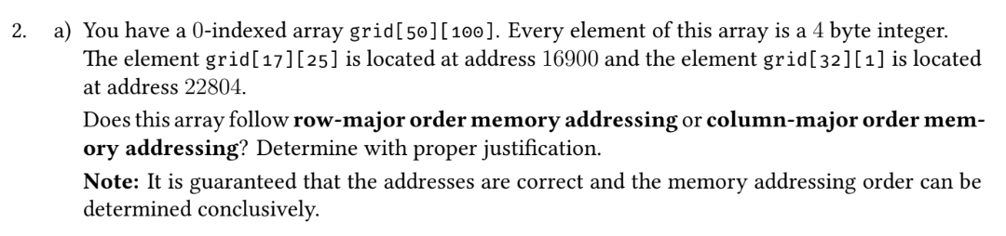

Slide 40
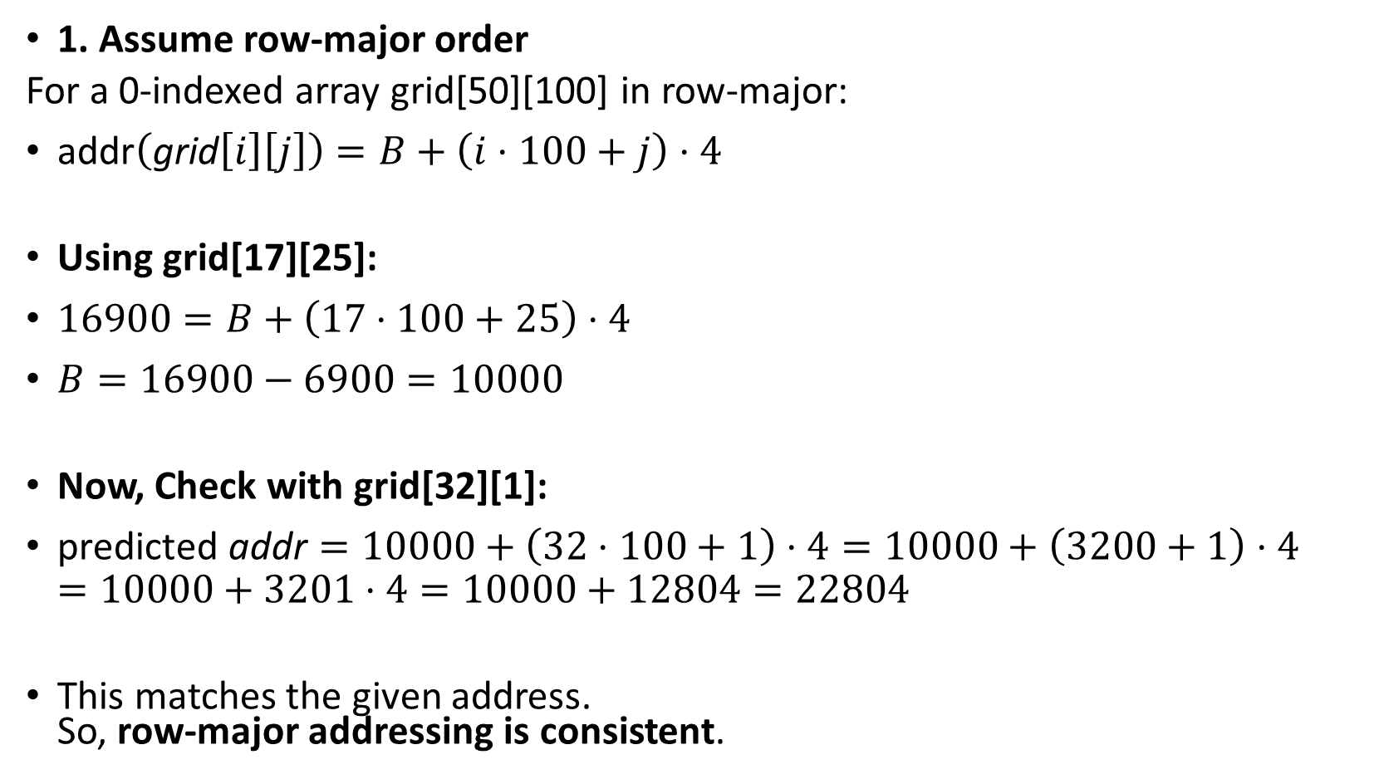
1. Assume row-major order
For a 0-indexed array grid[50][100] in row-major:
$\text{addr}\left(\text{grid}\left[i\right]\left[j\right]\right)=B+\left(i⋅100+j\right)⋅4$
Using grid[17][25]:
$16900=B+\left(17⋅100+25\right)⋅4$
$B=16900−6900=10000$
Now, Check with grid[32][1]:
$\text{predicted} \text{addr}=10000+\left(32⋅100+1\right)⋅4=10000+\left(3200+1\right)⋅4=10000+3201⋅4=10000+12804=22804$
This matches the given address. So, row-major addressing is consistent.

Slide 41
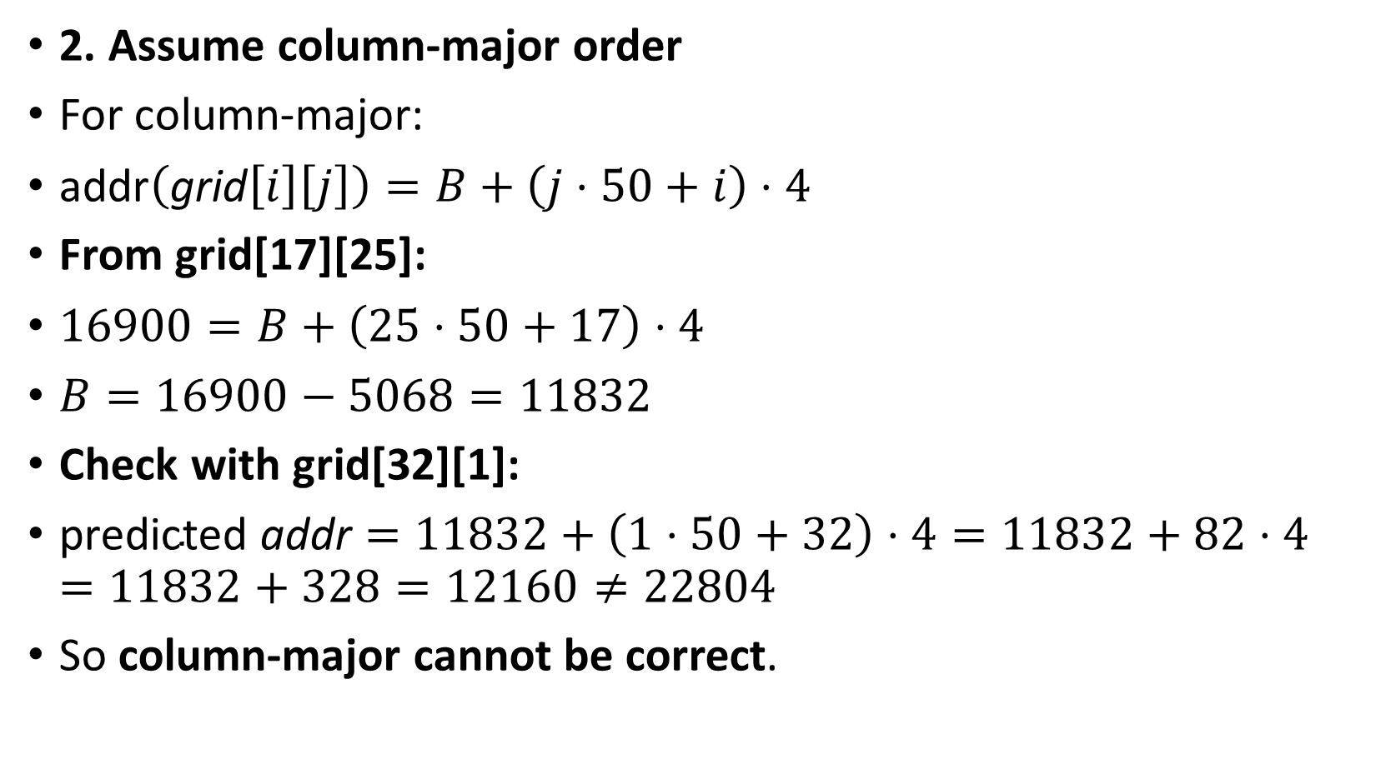
2. Assume column-major order
For column-major:
$\text{addr}\left(\text{grid}\left[i\right]\left[j\right]\right)=B+\left(j⋅50+i\right)⋅4$
From grid[17][25]:
$16900=B+\left(25⋅50+17\right)⋅4$
$B=16900−5068=11832$
Check with grid[32][1]:
$\text{predicted} \text{addr}=11832+\left(1⋅50+32\right)⋅4=11832+82⋅4=11832+328=12160≠22804$
So column-major cannot be correct.

